Slide 1
Git Training
September 2017
Notes:
I hope you have your fidget spinners from TLCC ☺
I am going to cover Git concepts and some basic commands
Give credit to Git in a Month of Lunches

Slide 2
Git tools
Git
Git bash
gitk
git gui
citool
BitBucket
Markdown language
Git
Mercurial
SourceTree
GitKraken
Notes:
Links will be provided in the notes for this presentation

Slide 3
Git terminology
Commit – is a saved change saved to a repository
Branch – Another path, or line, of development
Clone – Makes a copy of a repository
Repository – A storage area for files
Staging area – A feature of Git that enables the developer to commit certain parts of files instead of the whole file
Timeline – A set of events ordered by time, also known as history
Version Control – The practice of keeping track of changes such that you can always go back to a know state.
Notes:
If you want to try a new idea in your code, create your own branch. Because you’re working in a local repository, no other developer is disturbed by this new code stream. Your work is safe and isolated.
The Staging area allows you to commit part of a file

Slide 4
Commonly used commands - 1
add - Add file contents to the index
bisect - Find by binary search the change that introduced a bug
branch - List, create, or delete branches
checkout - Checkout a branch or paths to the working tree
clone - Clone a repository into a new directory
commit - Record changes to the repository
diff - Show changes between commits, commit and working tree, etc
fetch - Download objects and refs from another repository
Notes:
Git was created by Linus Torvalds (the guy who created Linux) so the commands are very similar and everything is case sensitive.

Slide 5
Commonly used commands - 2
grep - Print lines matching a pattern
init - Create empty git repository or reinitialize an existing one
log - Show commit logs
merge - Join two or more development histories together
mv - Move or rename a file, a directory, or a symlink
pull - Fetch from and merge another repository or a local branch
push - Update remote refs along with associated objects
rebase - Forward-port local commits to the updated upstream head
Notes:
A command switch that is a single letter normally has one hyphen git -g
A command switch that is a whole word normally has a double hyphon git --add

Slide 6
Commonly used commands - 3
reset - Reset current HEAD to the specified state
rm - Remove files from the working tree and from the index
show - Show various types of objects
status - Show the working tree status
tag - Create, list, delete or verify a tag object signed with GPG
See 'git help <command>' for more information on a specific command.
Notes:
Man(ual) pages
git help -a Print all available Git commands
git --paginate help -a Paginate the display of all Git commands
git help -g Print all available Git guides
git help glossary Display the Git glossary

Slide 7
Linux commands
pwd – print working directory
ls – list (dir)
mkdir –make directory
cd – change directory
history – see what you have typed
<tab> autocomplete
Git help help
Git help –g
Git help glossary
Ctrl-U to erase everything to the left of the cursor
Ctrl-K to erase everything to the right of cursor
Ctrl-A positions your cursor at the beginning of the line
Ctrl-E positions your cursor at the end of the line.
Ctrl-D - Delete key
Ctrl-H - Backspace key
Notes:
These will help you navigate through the CLI if you are not familiar with the LINUX CLI

Slide 8
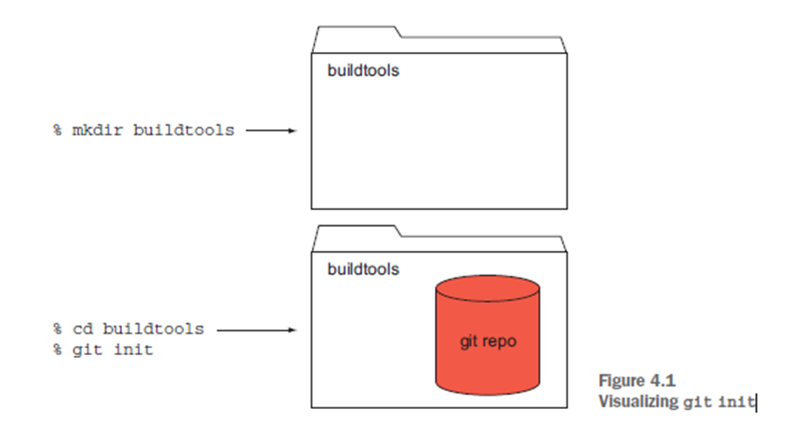
Notes:
Visual of a folder and a folder that was initialized so it is a git repository

Slide 9
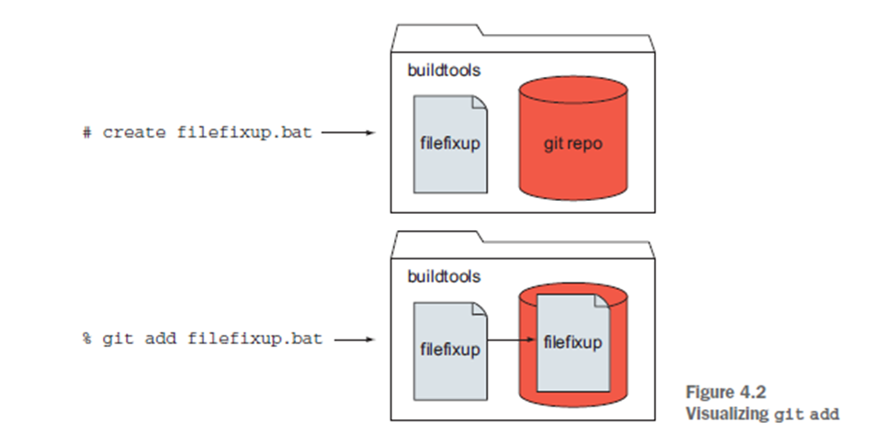
Notes:
Saving a file to the local folder then adding it to the repo
Git add
Git commit
This is just your local copy with a remote like bit bucket you would need to use
Git push

Slide 10
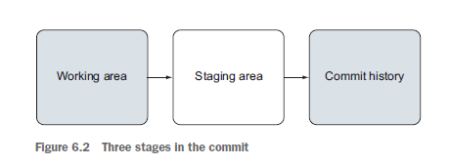
Notes:
Git add puts the file in the staging area
Git Commit saves it to the repository

Slide 11
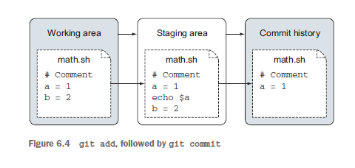
Notes:
Git history will only show the difference between what was there and what has changed

Slide 12
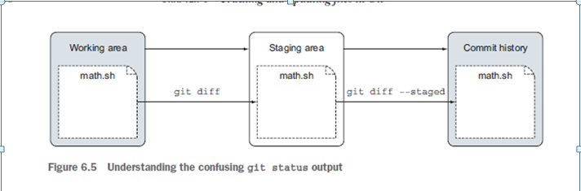
Notes:
You can look at the difference file between the working area, the staging area and the repository

Slide 13
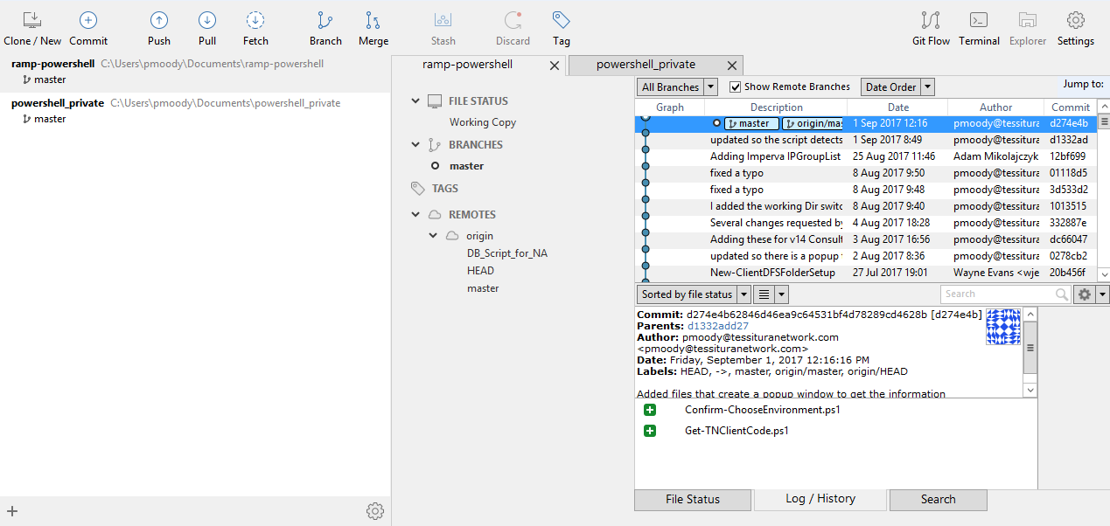
SourceTree
Notes:
Why should I care about all this who ha; I don’t want to see behind the curtain?
Everything you are doing through Sourcetree is using Git bash in the background to do the work.
If you want to automate Git processes you can utilize git through Powershell and then it will all be command line.

Slide 14
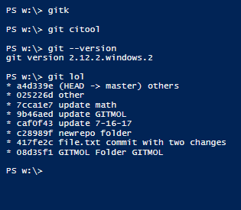

Slide 15
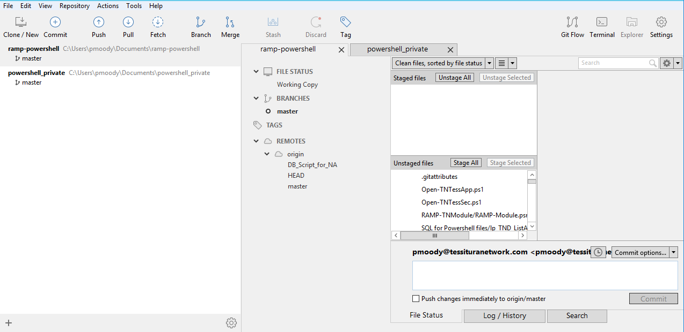
Notes:
This is where you can stage files and commit lines vs files and add the commit message

Slide 16
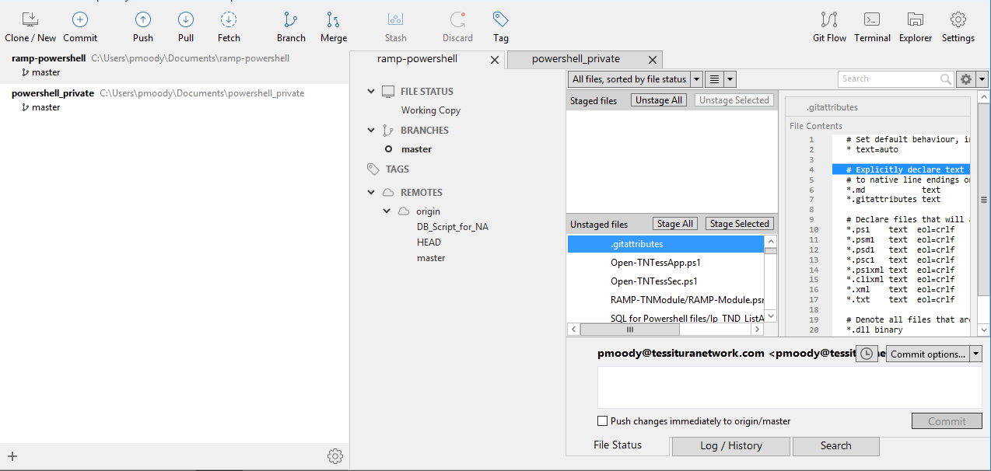
Notes:
If a file is selected…

Slide 17
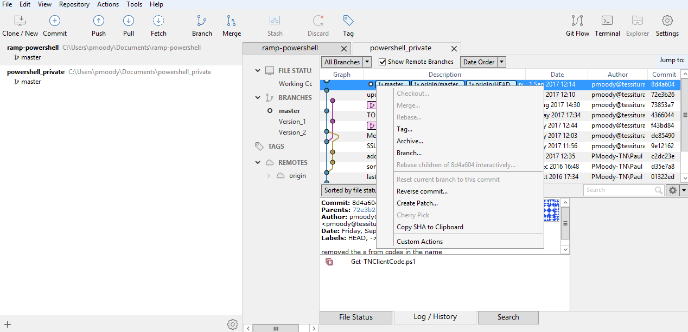
Notes:
Discuss Tags
Discuss the version of Source Tree

Slide 18
When Should you commit?
It makes sense to commit to the repository under any of these conditions:
■ Adding or deleting a file
■ Renaming a file
■ Updating a file to a known good working state
■ When you anticipate being away from the work
■ When you introduce some questionable code
Notes:
Commits save changes to the repository – when should I do this?

Slide 19
How to commit
Commit changes with the log message entered on command
line via the -m switch: git commit -m "Message“
git commit --amend -m "Fixed commit" -m "Second paragraph" -m "Wall of text“
citool
Use source tree – stage the file, enter a comment, press the commit button
Notes:
It is simple to commit

Slide 20
Comment example
Summary description – less than fifty characters
Empty line
As much as you need to explain what changed.
Notes:
Comments are important – everything should have a comment.
Do what I say, don’t do what I do (don’t look at my examples in the repository.)

Slide 21
Comments – what to say
“Though not required, it’s a good idea to begin the commit message
with a single short (less than 50-character) line summarizing the change, followed by
a blank line and then a more thorough description.”
When you’re writing a commit log message, anything that isn’t in code or a code
comment is a candidate for documentation in the commit message. The moment
when you’re committing code is the best time to write the reasons that you’re making
the change. At code commit time, you’re the best and most experienced person (and
your memory is freshest) at that moment. Take advantage of the moment by writing a
commit message that will help you or a fellow developer in the future.
git commit --amend command. This helpful command lets you
edit your most recent commit.
Notes:
Details details & git commit –amend
Anything that is not in the code that helps explain the change.

Slide 22

Master, Head, and…
Notes:
Git allows time travel – but nothing as cool as the tartis.

Slide 23
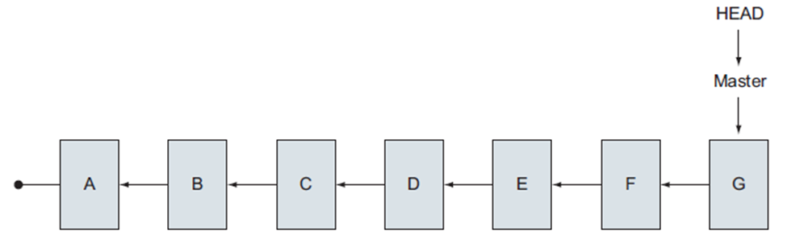
Notes:
Letters represent tags…

Slide 24
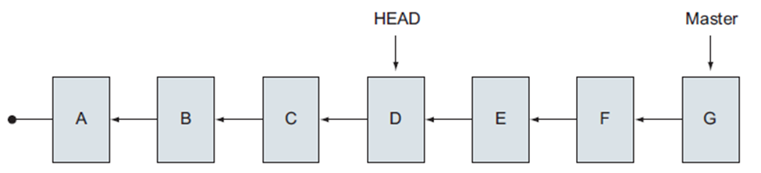
Notes:
You are looking back in time (spooky sound effects?)

Slide 25
The master branch represents the entire line of development, master
is also a reference, or a pointer, to the last commit made on this branch. This is
why I drew master with an arrow pointing to the last commit. Git always keeps master
pointed at this last commit, and this is how you can safely travel back in time: you
know that master points to the last commit (which is your present)!
The last piece that you need for time travel is the device that does the travel. It
turns out that Git supplies this device by default: it’s your HEAD.
At its simplest, the HEAD is the current branch. This HEAD is analogous to the laser in
a CD/DVD player. HEAD is also your actual head. What is your head (you) looking at right now?
When you read Git documentation, HEAD, is always capitalized.
Notes:
The logic and details behind the versions (how to travel back and forth)

Slide 26
The commands to move around in Time
git rev-parse HEAD
git rev-parse master
git checkout SHA1ID
git checkout your_tag_name
git checkout master
Notes:
Git rev-parse gives you the SHA1 ID (bcaa6e)

Slide 27
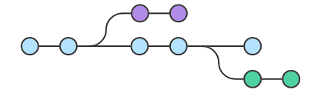
Branches
Notes:
There is a lot of power here.
They are easy to create
They isolate your work

Slide 28
When to create a branch
In general, you’ll want to create a branch for two common scenarios:
introducing new code
fixing existing code
Notes:
git log --graph --decorate --pretty=oneline
--all --abbrev-commit
Git lol

Slide 29
More commands
git checkout -b another_fix_branch fixing_readme
git config --global alias.lol "log --graph --decorate --pretty=oneline --all --abbrev-commit"
Git lol
git reflog – shows all the times you have changed branches
Deleting a branch
git checkout master
git branch -d fixing_readme
Notes:
Making aliases is handy for long commands that you want to use regularly. One that is used in a lot of online documentation that I find handy is lol

Slide 30
Switching branches safely
Multitasking in your code base becomes easy, because creating and switching
branches is so easy. But if you’re in the middle of some work (you have uncommitted
changes in your working directory), Git won’t allow you to check out another branch.
You must put this work aside properly.
Notes:
If you try to switch and you have unsaved work it won’t let you switch you will need to stash your work or commit your work.

Slide 31
Stash your work
Git does have a facility for putting aside your work temporarily: the git stash command.
You can use this to save all your work temporarily, leaving you with a clean
working directory. Think of it as a temporary commit!
git stash
git stash list
git stash pop

Slide 32

Merging Branches
Notes:
Make it so everyone can see your work

Slide 33

Know where you are
Branches merge into whatever branch you are on!

Slide 34
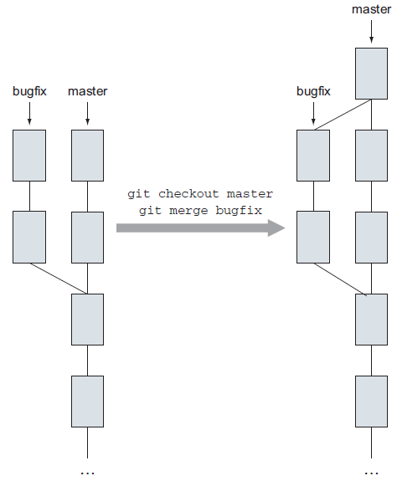
Notes:
This is an example of a merge

Slide 35

Merge Conflicts will happen
Atlassian’s documentation on the subject:
https://confluence.atlassian.com/bitbucket/resolve-merge-conflicts-704414003.html
Notes:
There is a lot on this subject and it can be tricky, there are several tools to choose from. I watched an hour and a half video on merge conflicts from channel 9

Slide 36
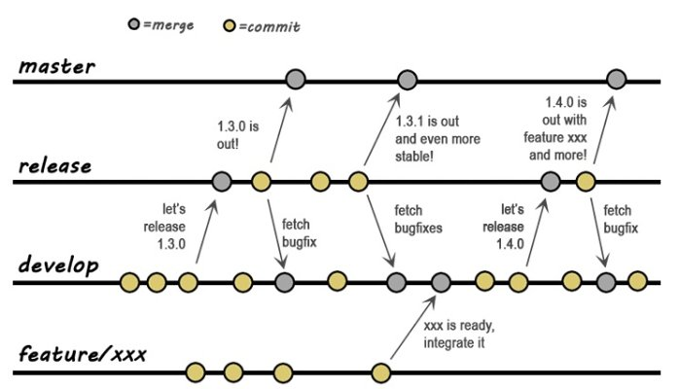
A different model
Notes:
This is an application model of how to use versioning to control the different stages of work.
What model do we want to use?

Slide 37
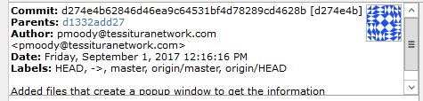
Fast Forward
If git detects that the branch being merged is a direct descendant of the current
branch, it moves the local branch (master) up to the remote branch
(new_feature). This is what is meant by fast-forward.
Notes:
Sorry – I’m not moving faster but ff

Slide 38
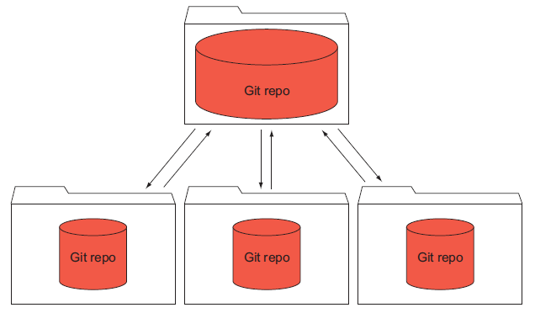
cloning
Notes:
Cloning is a copy of the repository but…

Slide 39
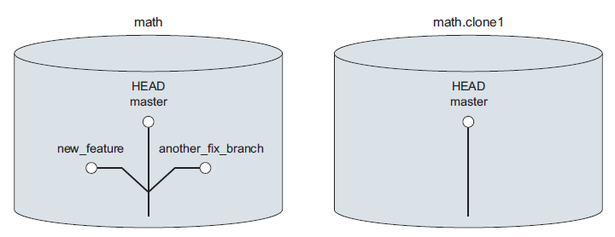
Notes:
Once you start to using branches you need to know that branches aren’t copied by default.
You need to use the --all switch

Slide 40
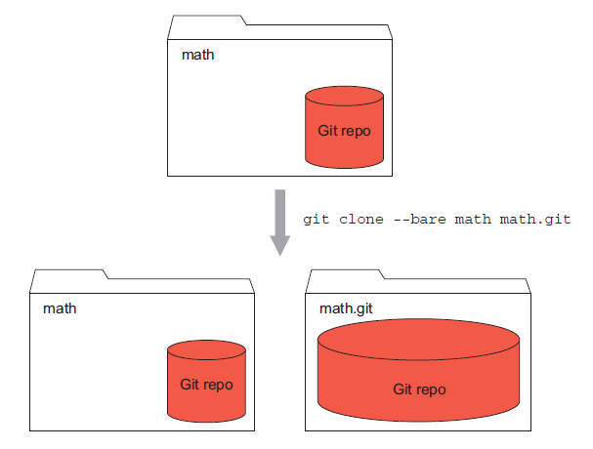
Notes:
--bare is how a repository on bitbucket or github – there is no working directory
git clone math.git math.clone3

Slide 41
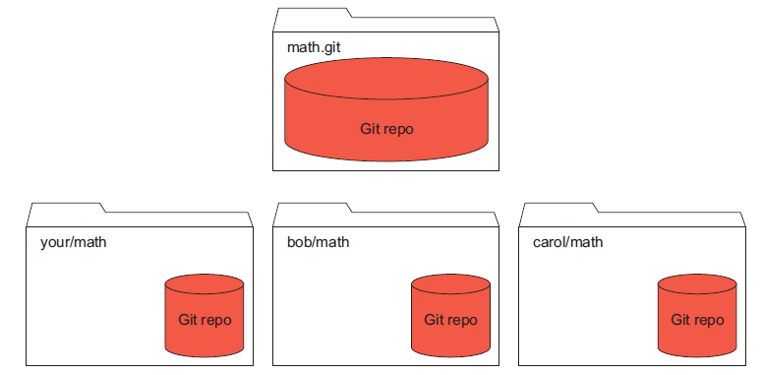
Notes:
This is sort of how we work … the top folder is bitbucket and we all have clones of that repository that are working directories.

Slide 42
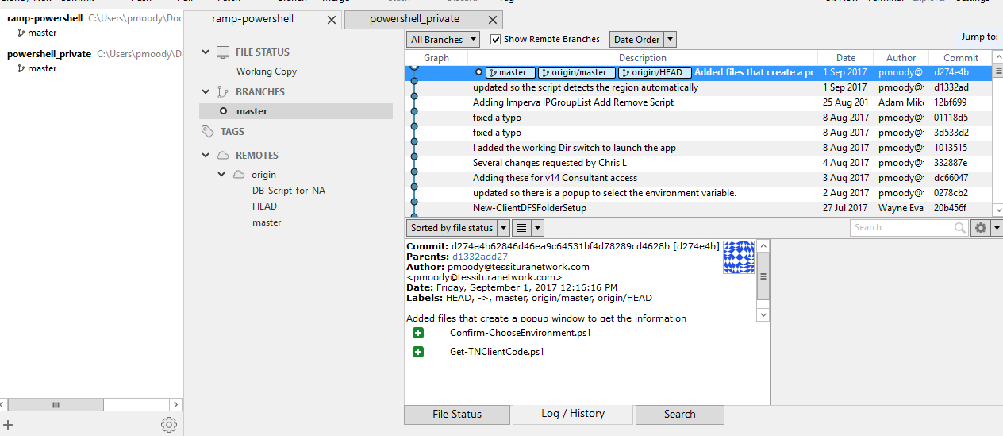
Notes:
Looking at our repository you will see origin because it is a remote repository
Origin, master, HEAD, origin HEAD
git remote
git ls-remote
git ls-remote origin
git ls-remote bob
cd $HOME
git clone https://github.com/rickumali/math.git math.github

Slide 43
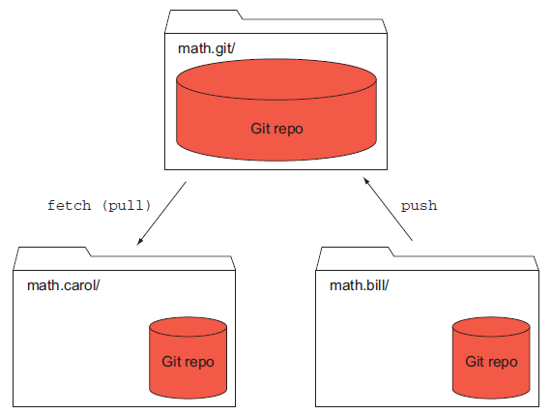
Push & Pull
Notes:
Push, Pull and Merges can cause conflicts

Slide 44
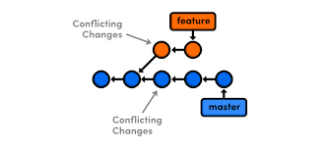
Push & Pull
Notes:
Repo: a=0
Bill: a=1
Carol: a=2
There is a conflict
Git pull --ff-only will only pull direct descendants and there will be no conflicts but you may not see all updates to the repo.

Slide 45
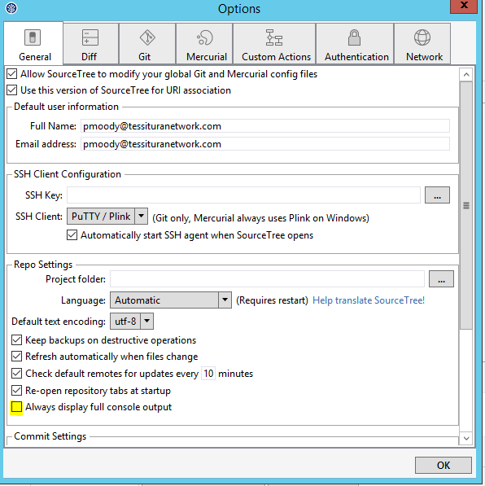
Sourcetree can help teach CLI

Slide 46

Let’s Talk

Slide 47
Conventions for commits
Making a commit means updating your local timeline. When you make a commit,
you’re stating that the current directory of code represents a certain state. Your commit
log message should indicate that current state, and how the change brings us
there. For example, a good commit log subject is Fixed bug 17414, the data shift
issue. This means that the changes introduced by this commit fix this particular bug.
Because Git is a distributed version-control system, each individual user can make
commits at any time to their local repository. Some organizations might stipulate that
a commit must not break the build, or that a commit must be accompanied by a unit
test. You might even see some places try to enforce how the commit message should
be written.
The only guideline to try to follow is to keep the Git commit subject (that first line
in a commit message) under 50 characters. This way, the output of git log --oneline
won’t be truncated or wrapped.
Your local commits do become public when you push code, however.
Notes:
Just what was mentioned before

Slide 48
Conventions for pushing code
Conventions for pushing code to a shared repository must be agreed upon. Because
Git is a distributed version-control system, there might be more than one remote, but
most places do use a shared server where the official code base resides. This shared
server is often the location that automated testing, building, or deployment software
will reference.
Organizations have a wide range of options when it comes to the release process.
Some companies have departments that focus on release tasks. Some companies,
adopting continuous integration principles, follow a more automated approach.
Releasing code often includes preparing a release candidate from a branch that
builds cleanly.
Because Git allows everyone to have the entire repository, it may make sense to
limit who can push to where. Individual developers can commit as often as they’d like
to their local repository, but the group or automation that deploys or builds the
release may want to build up their own repository by pulling from individual repositories.
Allowing everyone the ability to push to the official code base can get messy.
Notes:
Do we want any rules to what gets pushed?

Slide 49
Conventions for branching
Some organizations may want to control the number of branches in the shared repository.
Users working on their local repository should feel empowered to create as
many local branches as they need to stay organized, but pushing such branches to a
shared server might require conventions.
One such convention could standardize the names of branches. Because branches
can be given any name, you might establish a convention requiring each branch to
have a folder-like name such as feature/new_field, which means a feature branch for
the new_field feature. Or the branch name could include the ID of the owner, which
makes it easy to detect who is doing what on a repository.
Branching is the heart of the workflows. Because a branch represents a snapshot of your code, different parts of a large organization may choose to have a repository with two or more active lines of development. One branch would be used by the developers, one by the automated tests,
another representing the deployed software, and so on.
Notes:
This is important if we want to move toward using GoCD for continuous integration, continuous delivery.

Slide 50
Git rebase standards
Do you want your code to have every incremental commit? Or is a single commit representing the entire work for a feature or bug fix sufficient? If so, your organization will want to set guidelines around when and how to rebase. Conversely, if your organization wants to maintain a complete and unaltered history of development, warts and all, it may prohibit developers from using the git rebase command.
Rebase is helpful for individual developers to use on their own branches to prepare
them for sharing. As discussed in chapter 16, cleaning up your work and making
a presentable set of commits that represent it is welcome.
Notes:
This rewrites your history and makes a base image; a powerful tool but make sure you understand when to use this.

Slide 51
Convention for tagging
The git tag command allows you to make bookmarks to any part of the commit history
timeline. But like commits, tags are considered local until they are pushed to the
main repository. As with branches, your company may want to impose a tag name convention.
You may want to use it only to mark code that has been released.
Notes:
Tagging can make git easier to use

Slide 52
Workflows
git-flow
http://nvie.com/posts/a-successful-git-branchingmodel/
The master branch contains released,
production-level code. This is what the public
can see, perhaps on a deployed website
or in some released software that they’ve
downloaded from you. The develop branch
contains code that is about to be released.
This is depicted in figure 17.1.

Slide 53
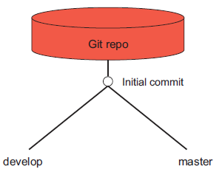
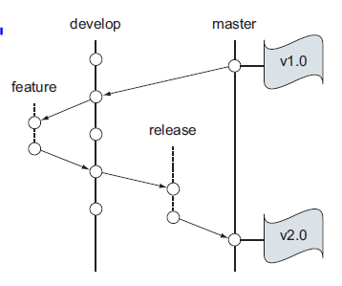
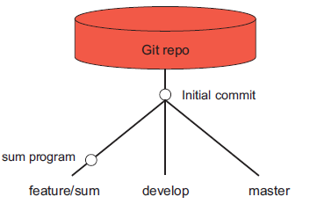
Notes:
Example of git-flow is a method of working and a command. If you click the gitflow button it will rebase and create the extra branches for you.

Slide 54
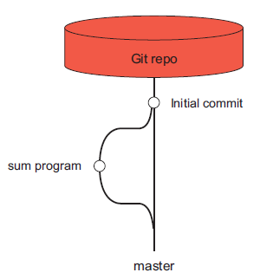
Github flow
Notes:
This is more of the model that we are using but we are putting all scripts in one repo with based on programming language rather than purpose.
Maybe: Network structure, infrastructure, server function, automation, testing, hardware vs application functionality

Slide 55
Repos for production & branch for dev?
Currently 00Prod and 00Dev are folders
Should these be repos the nvie model or should we have one folder that has a copy of ‘the’ repo and we checkout branches for the dev work?
In EU there are two 00Prod folders one in \\filer\software and one in \\filer\software\scripts\ currently this is a problem, which is correct? If these were repos it would matter.

Slide 56
Git bonus
Git can be configured to ignore files such as generated files that will appear in your working directory.
git help gitignore
git config core.excludesfile - shows files that are currently excluded
Git groups:
■ Git for Human Beings (Google Groups)
https://groups.google.com/group/git-users
■ Git Mailing List
git@vger.kernel.org
Details for joining this list are available at
https://git.wiki.kernel.org/index.php/GitCommunity
Notes:
Hand outs for all ☺

